Slide 1
Bio334 Phylogenetic reconstruction Part I: Distance-based methods
Janko Tackmann & Lukas Malfertheiner
For questions, feel free to contact us on Slack or via:
janko.tackmann@imls.uzh.ch or Lukas.malfertheiner@uzh.ch

Slide 2
Exercise 1 – Questions
Complexity

Slide 3
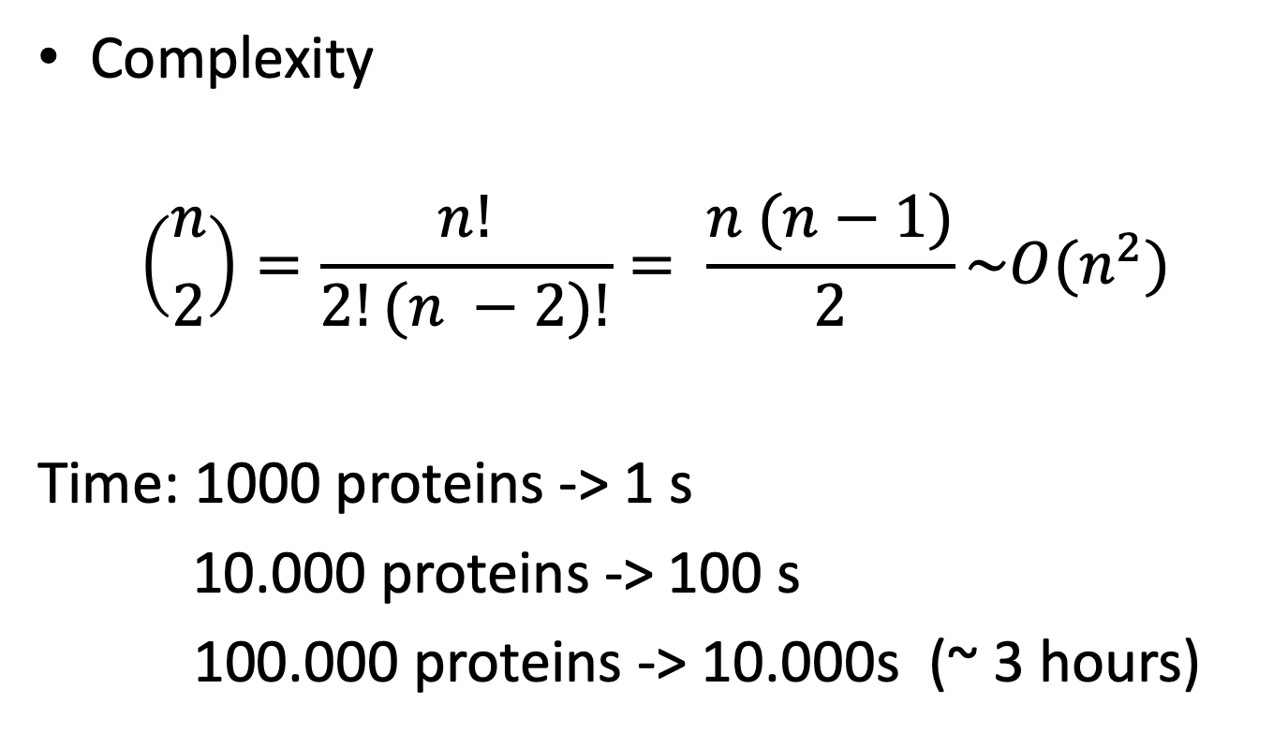
Exercise 1 – Questions
Complexity
$$\left({n \atop 2}\right)=\frac{n!}{2!(n −2)!}= \frac{n (n−1)}{2}\sim O(n^{2})$$
Time: 1000 proteins -> 1 s
10.000 proteins -> 100 s
100.000 proteins -> 10.000s (~ 3 hours)

Slide 4
Exercise 1 – Questions
Shortcomings of naïve Jaccard

Slide 5
Exercise 1 – Questions
Shortcomings of naïve Jaccard
All amino acid transitions have equal probability: unrealistic
Use explicit substitution matrices (BLOSUM, PAM)

Slide 7
Exercise 1 – Questions
Shortcomings of naïve Jaccard
All amino acid transitions have equal probability: unrealistic
Use explicit substitution matrices (BLOSUM, PAM)
Dependencies between neighboring sites (e.g. indels) are not considered
Smaller gap penalties, explicit modeling

Slide 8
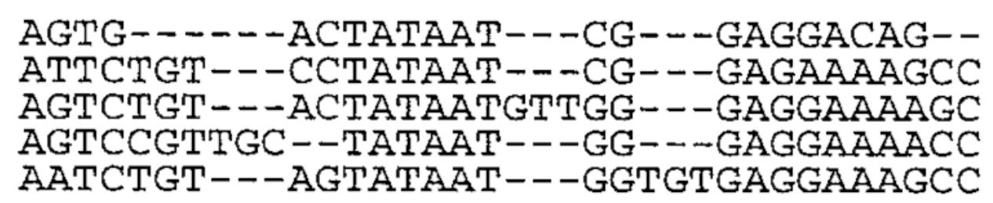

Slide 9
Exercise 1 – Questions
Nucleotides vs Amino acids

Slide 10
Exercise 1 – Questions
Nucleotides vs Amino acids
Nucleotides
High resolution: small differences can be detected
More neutrally evolving regions: less biased similarity estimates
Distinction between synonymous and non-synonymous mutations

Slide 11
Exercise 1 – Questions
Nucleotides vs Amino acids
Nucleotides
High resolution: small differences can be detected
More neutrally evolving regions: less biased similarity estimates
Distinction between synonymous and non-synonymous mutations
Amino acids
Stable over longer evolutionary time frames, used to address questions on non-recent evolution

Slide 12
Exercise 2 – Questions

Slide 13
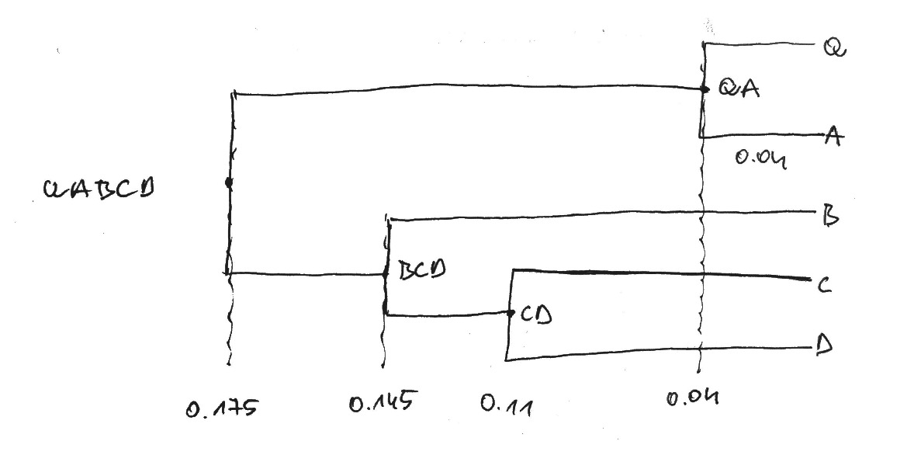

Slide 14
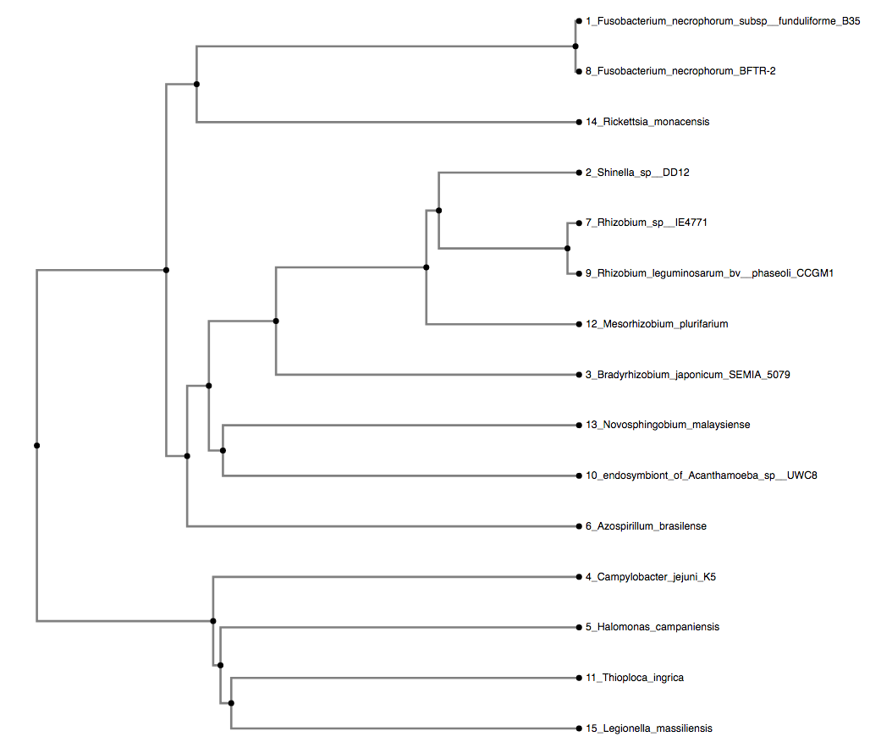
Exercise 3 – Questions

Slide 17
Fusobacterium necrophorum subsp. funduliforme B35

Slide 18
Fusobacterium
necrophorum
subsp. funduliforme
B35
Genus
Species
Subspecies
Type strain

Slide 19
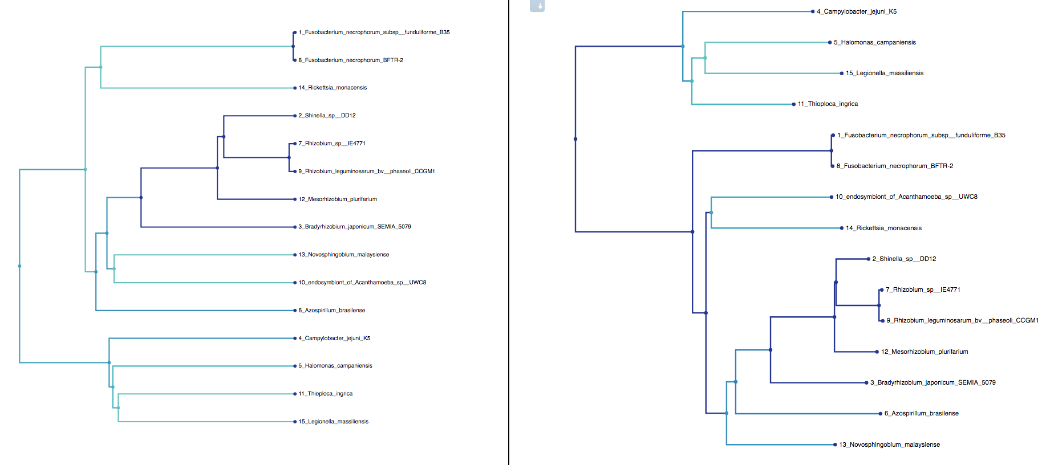
Exercise 4 – Questions

Slide 22
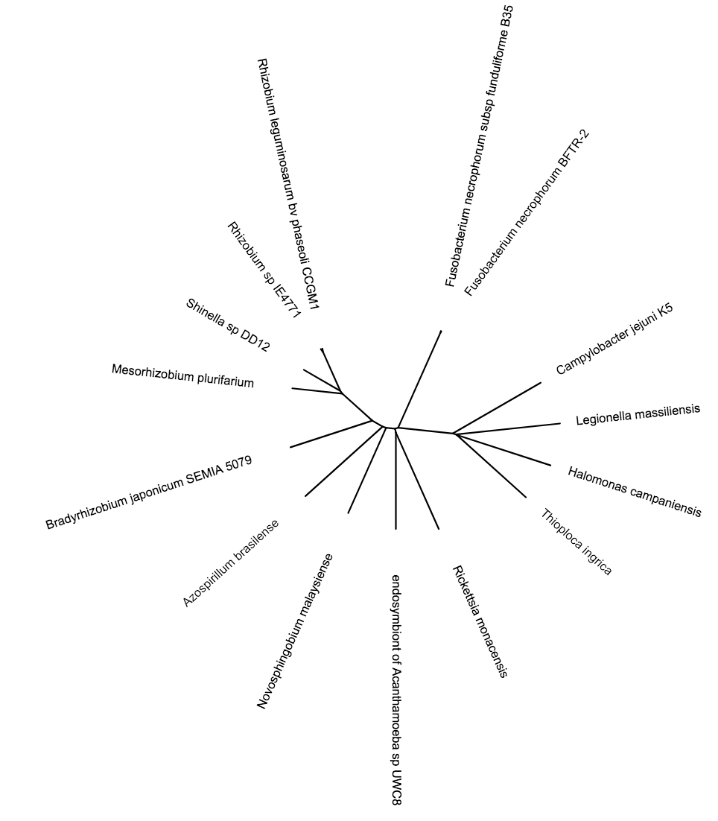

Slide 23
